Slide 1

Payments Classifier
André Oliveira

Slide 2
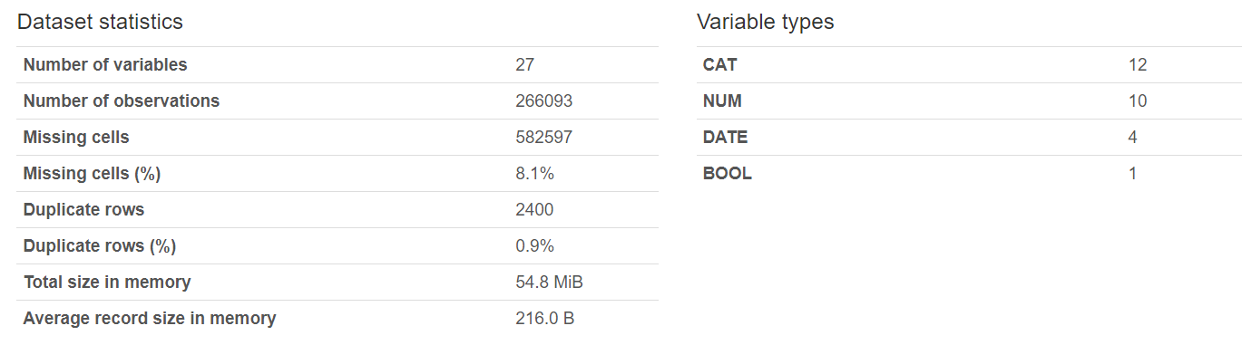
Scope
Build a Predict whether a payment occurs ahead of time, on time or if it is delayed.
Consider that a payment is on time if it occurs within the same month of the due date.
Dataset features are anonymized.

Slide 3
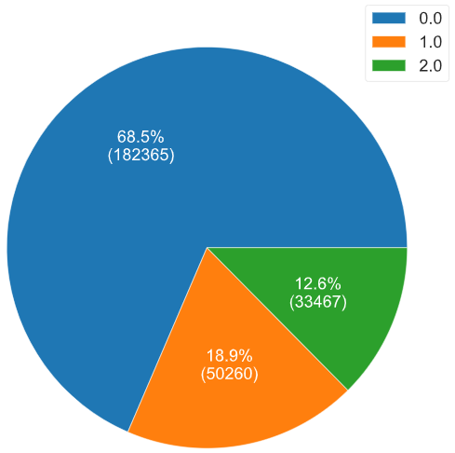
Exploratory Data Analysis
Feature Engineering
In order to predict the payments timeliness, a new feature was added based on the previous logic to be used as a target (Payment Timeliness).
A feature was added (Time Delta) to address the relationship between the date fields Datum and Due Date, avoiding the usage of any processed date related fields in the model and reducing the model complexity.
The target feature (Payment Timeliness) is quite unbalanced.
The features MANSP, CTLPC, HISTORICRATING and CURRENTRATING are almost empty, therefore they were removed from the list of relevant features.
Payments Timeliness – Value Count by Class

Slide 4
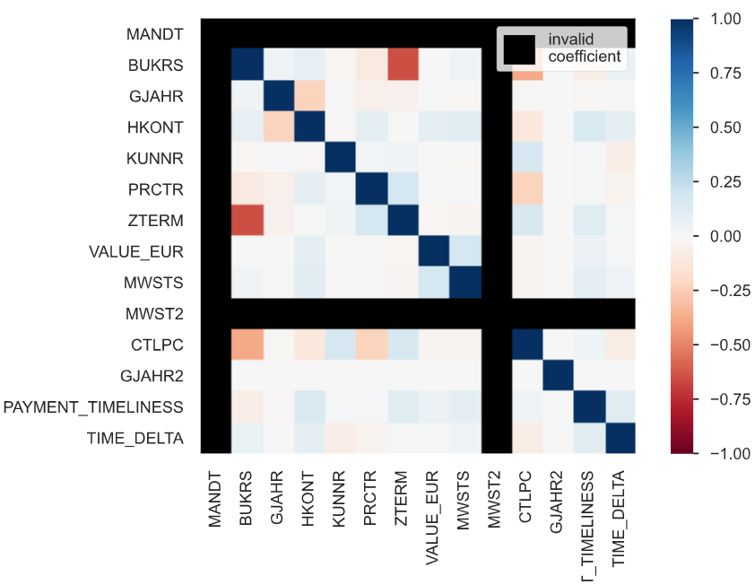
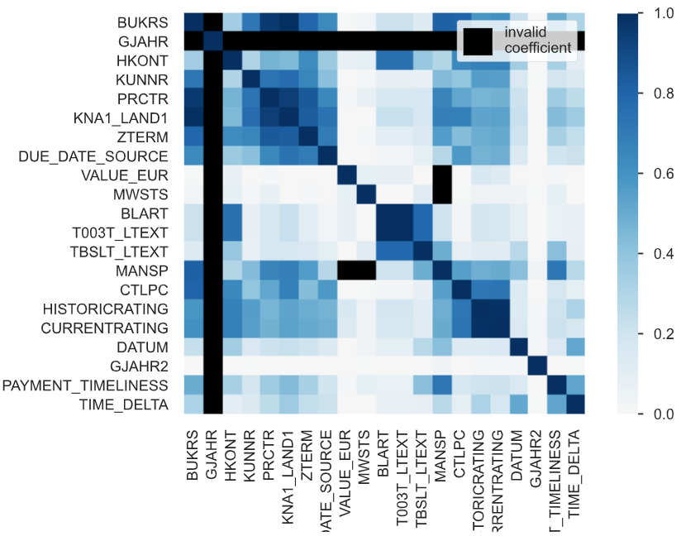
Exploratory Data Analysis
Pearson’s
Correlation
When analyzing the Pearson’s correlation, it is visible that there is not much linear correlation between the payment timeliness and other variables.
When analyzing the Phik’s correlation – a measure suitable for categorical, ordinal and interval variables that captures non-linear dependency – it is visible that there is some correlation between the payment timeliness and the variables KNA1_LAND1, MANSP, BURKS, TBSLT_LTEXT and TIME_DELTA.
Phik’s

Slide 5
Methodology
Approach
As the correlation analysis was not conclusive to identify a final set of relevant features to model in order to predict the payments timeliness, the approach was based on using the feature importance of a model.
The selected model was Gradient Boosting, as it performs well on unbalanced data. It is a type of machine learning model that creates an ensemble based on multiple weak leaners (decision trees). It starts by fitting an initial model to the data, then a second model is built that focuses on accurately predicting the cases where the first model performs poorly. The combination of these two models is expected to be better than either model alone. Then this process is repeated over and over again.
The hyperparameter tuning method was Bayesian Optimization, conscious of computing performance.
The dataset was split in 2 sets to avoid data leakage:
Train – used to train the model and perform the hyperparameter tuning with cross-validation.
Test – used to evaluate the model.

Slide 6
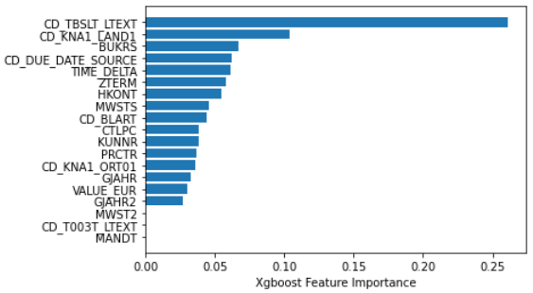
Methodology
Main Drivers of Payment Timeliness
The final list of features to include in the model was defined using the feature importance of the gradient boosting model that included all features of the dataset.
Evaluation Metrics
F1 score.
Accuracy.
Precision.
Recall.
ROC AUC.

Slide 7
Results
The overall accuracy results are reasonably good, achieving more than 80% of accuracy.
However, as this is a multi-class problem, it is important to check the other evaluation metrics by label.
The class imbalance causes significant drops on the precision, recall and F1 score for both labels 1 and 2.
The ROC AUC numbers are quite uniform for all labels, enough to deem the model as acceptable.
In order to improve the classifier, the class imbalance should be addressed, adopting for instance resampling techniques of under-sampling or over-sampling.
Label | F1 score | Precision | Recall | ROC AUC | Accuracy
0 On time | 0.89 | 0.85 | 0.94 | 0.78 | -
1 Not on time | 0.64 | 0.76 | 0.56 | 0.76 | -
2 Ahead of time | 0.72 | 0.80 | 0.65 | 0.81 | -
Average | 0.75 | 0.81 | 0.71 | 0.78 | 0.83

